Slide 1


Slide 2


Topic – 6 Network Analysis of Tweets
Text Analytics
Notes:
Do we know the topic number for this?

Slide 3

Network Analysis of Tweets
Notes:
In this session we are going to learn how to build and analyse a network from tweets.

Slide 4
INDEX
What is a Network?
Types of Networks
Weighted Networks
What is an Adjacency matrix?
How to create an adjacency matrix?
Adjacency Matrix – Tweets data example
Degree of a Network
Building a Network of tweets in R

Slide 5
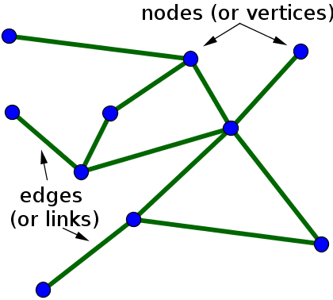
What is a network?
A network is simply a collection of connected objects.
The objects are called as “nodes” or “vertices”
The connections between the nodes are called as “edges” or “links”
Fig . An undirected network with 10 nodes and 11 edges
Notes:
Networks can represent all sorts of systems in the real world.
For example, one could describe the Internet as a network where the nodes are computers or other devices and the edges are physical (or wireless, even) connections between the devices. The World Wide Web is a huge network where the pages are nodes and links are the edges.
Other examples include social networks of acquaintances like in facebook-linkedin, basically where a network is comprised of you and your friends.

Slide 6
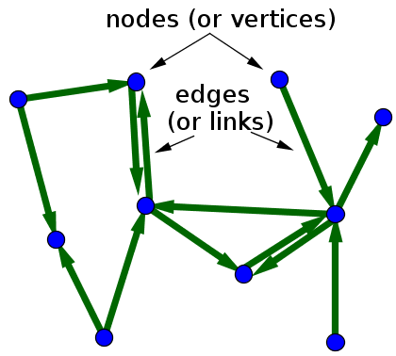
Types of Networks
Undirected Network
A Network where all the edges are bidirectional.
Directed Network
A Network where all the edges are directed from one vertex to another
When drawing a directed graph, the edges are typically drawn as arrows indicating the direction
Notes:
For the sake of simplicity in this session let’s understand more of undirected networks

Slide 7
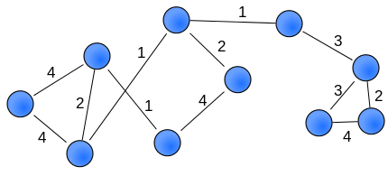
Weighted Networks
Here, the weights are visualized by giving edges different widths
Notes:
In some networks, not all nodes and edges are created equal.
For example, in metabolic networks, nodes may indicate different enzymes which have a wide variety of behaviors, and edges may indicate vastly different types of interactions.
To model such difference, one can introduce different types of nodes and edges in the network. In networks where the differences among nodes and edges can be captured by a single number that, for example, indicates the strength of the interaction, a good model may be a weighted graph. One can represent a weighted graph by different sizes of nodes and edges.
Below is an example
weights can also be visualized by giving edges different widths
Now in social networks, say linkedin or facebook :
some contacts are friends, whereas others are simply acquaintances.So here
The nodes are of different nature
The edges are of different widths.
And the “nature of friendship” is the weight given.

Slide 8
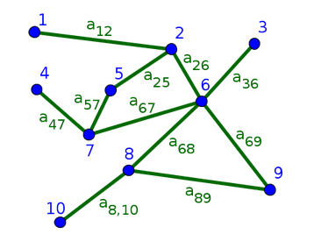

What is an Adjacency Matrix?
The adjacency matrix for a network of N nodes is a matrix of ones and zeros where a one indicates the presence of the corresponding edge in the network
We read the indices from right to left so that we define A by :
Notes:
The adjacency matrix for a network of N nodes is a matrix of ones and zeros where a one indicates the presence of the corresponding edge in the network
This is however for unweighted networks.
So for example here a12 refers to an edge from node 2 to node1
a25 refers to an edge from node 5 to node 2

Slide 9
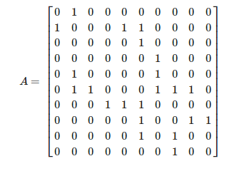
What is an Adjacency Matrix?
Undirected Network
Adjacency Matrix
Notes:
For undirected graph represented in the above figure,
can see in the matrix,one indicates the presence of the corresponding edge in the network
So looking at the first row, it has only a single 1 , this is a12.that is node1 has only 1 edge
For the second row, there are 3 1’s.this is for node2.For node 2, there are 3 edges from node1,node5 and node6.
the eleven edges lead to 22 ones in the adjacency matrix since, by symmetry, each edge leads to two entries in the matrix.
For undirected graphs, the convention for denoting the adjacency matrix doesn't matter, as all edges are bidirectional. In this The bidirectionality means that the adjacency matrix is symmetric. The symmetry of A means that the rows are equal to the columns.
For example, the edge between nodes 1 and 2 leads to a12=1 and a21=1, though we've labeled it by just a12 in the above figure.

Slide 10
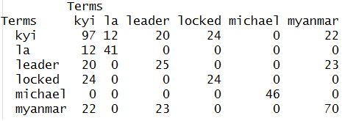
Adjacency Matrix – Tweets data example
Terms in Tweets
Notes:
The adjacency matrix for the words in the tweet documents look as shown in the diagram.This is an example of a weighted network.
So how to create this , we will take a look at that while we solve a case study in R
Here the “words” act as the nodes.
This matrix basically gives you an impulse of which words occur frequently with other words in the document.
Let’s see How to interpret this matrix :
Let’s choose the word “Kyi” .This is the name of the opposition Party leader in “Mynmar” .There were many tweets in the about Obama visiting Mynmar and meeting up with Kyi.
Kyi occurs 97 times across all tweets. Hence the matrix shows “kyi” with “kyi”
The number 12 in the matrix means that “Kyi” occurs 12 times with the word ”la”
20 times with the word “leader”
And so forth.
So this matrix reports the # times each word occurs with other words.

Slide 11
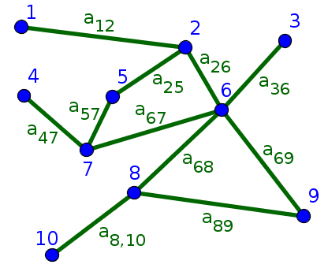
Degree of a Network
In an undirected network, the degree in a network is the number of connections it has to other nodes
Notes:
We will be discussing about undirected networks for the sake of simplicity
In an undirected network, the degree in a network is the number of connections it has to other nodes
So here for node1 , the degree is 1
For node2, it has 3 edges, hence the degree is 3 and so forth.
If these nodes were your Facebook friends, then the degree would represent the “Number of friends” you had
IF these nodes are words that belong to “tweets”, then it talks about which words together form a network, ie commonly occur together ,as we saw in the previous example of adjacency matrix

Slide 12

RECAP
Notes:
Closing Audio to be recorded
Under this topic we have discussed in detail about
…..
That’s it for this topic.
For any queries, do email us at info@jigsawacademy.com
Thanks!

Slide 13
THANK YOU

